Slide 1
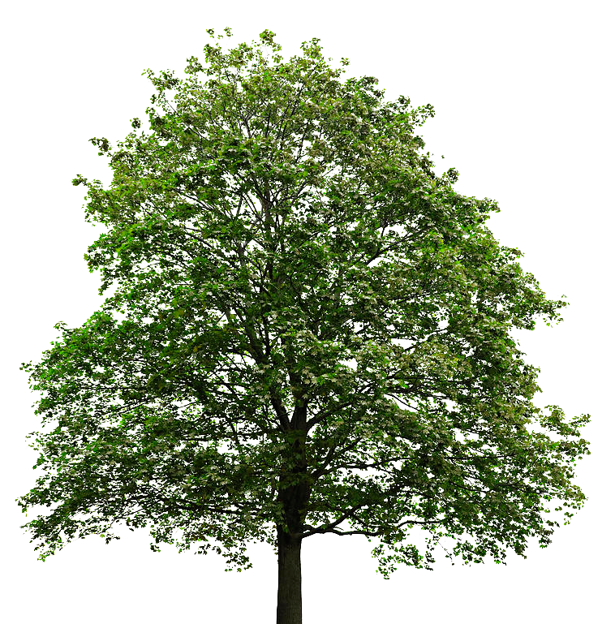
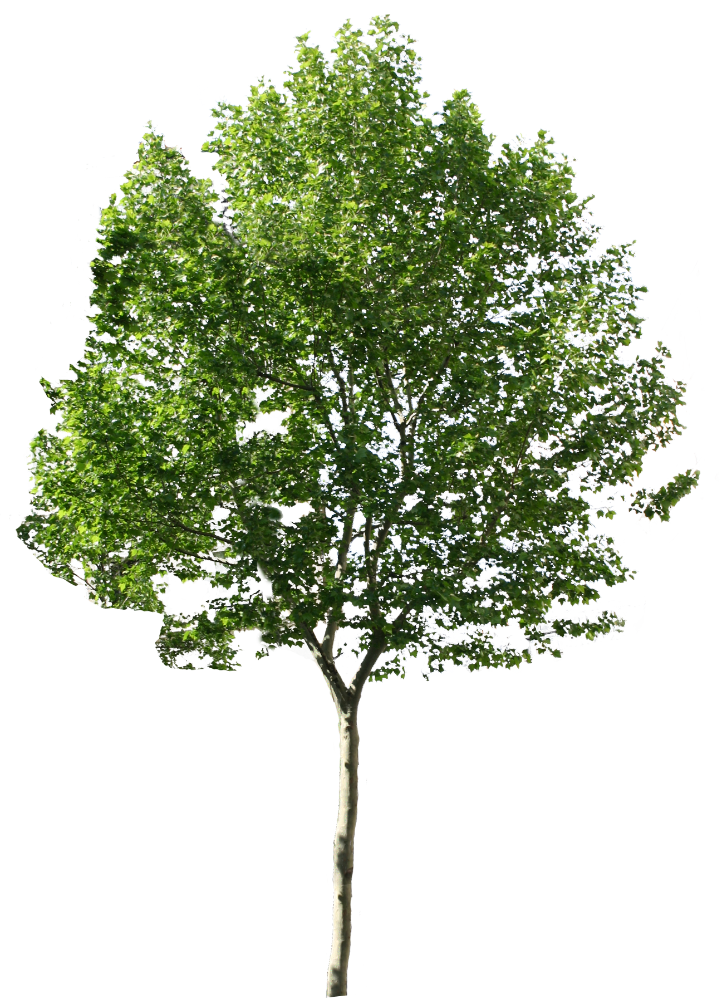


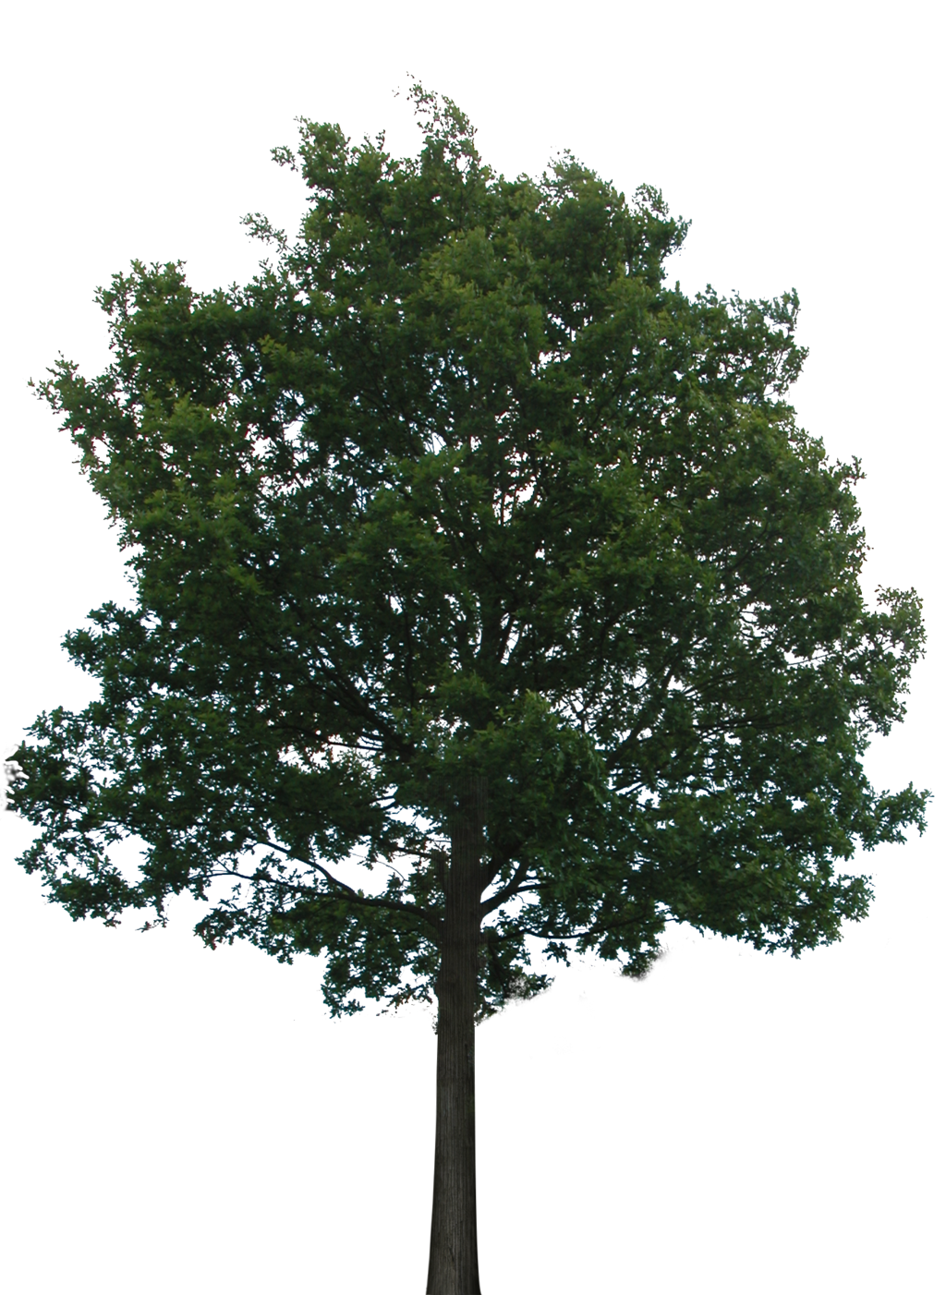
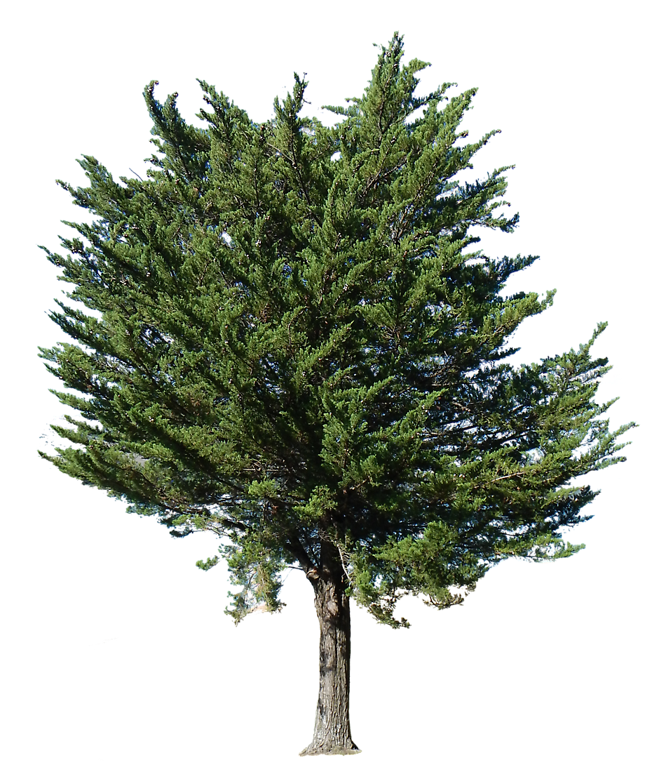

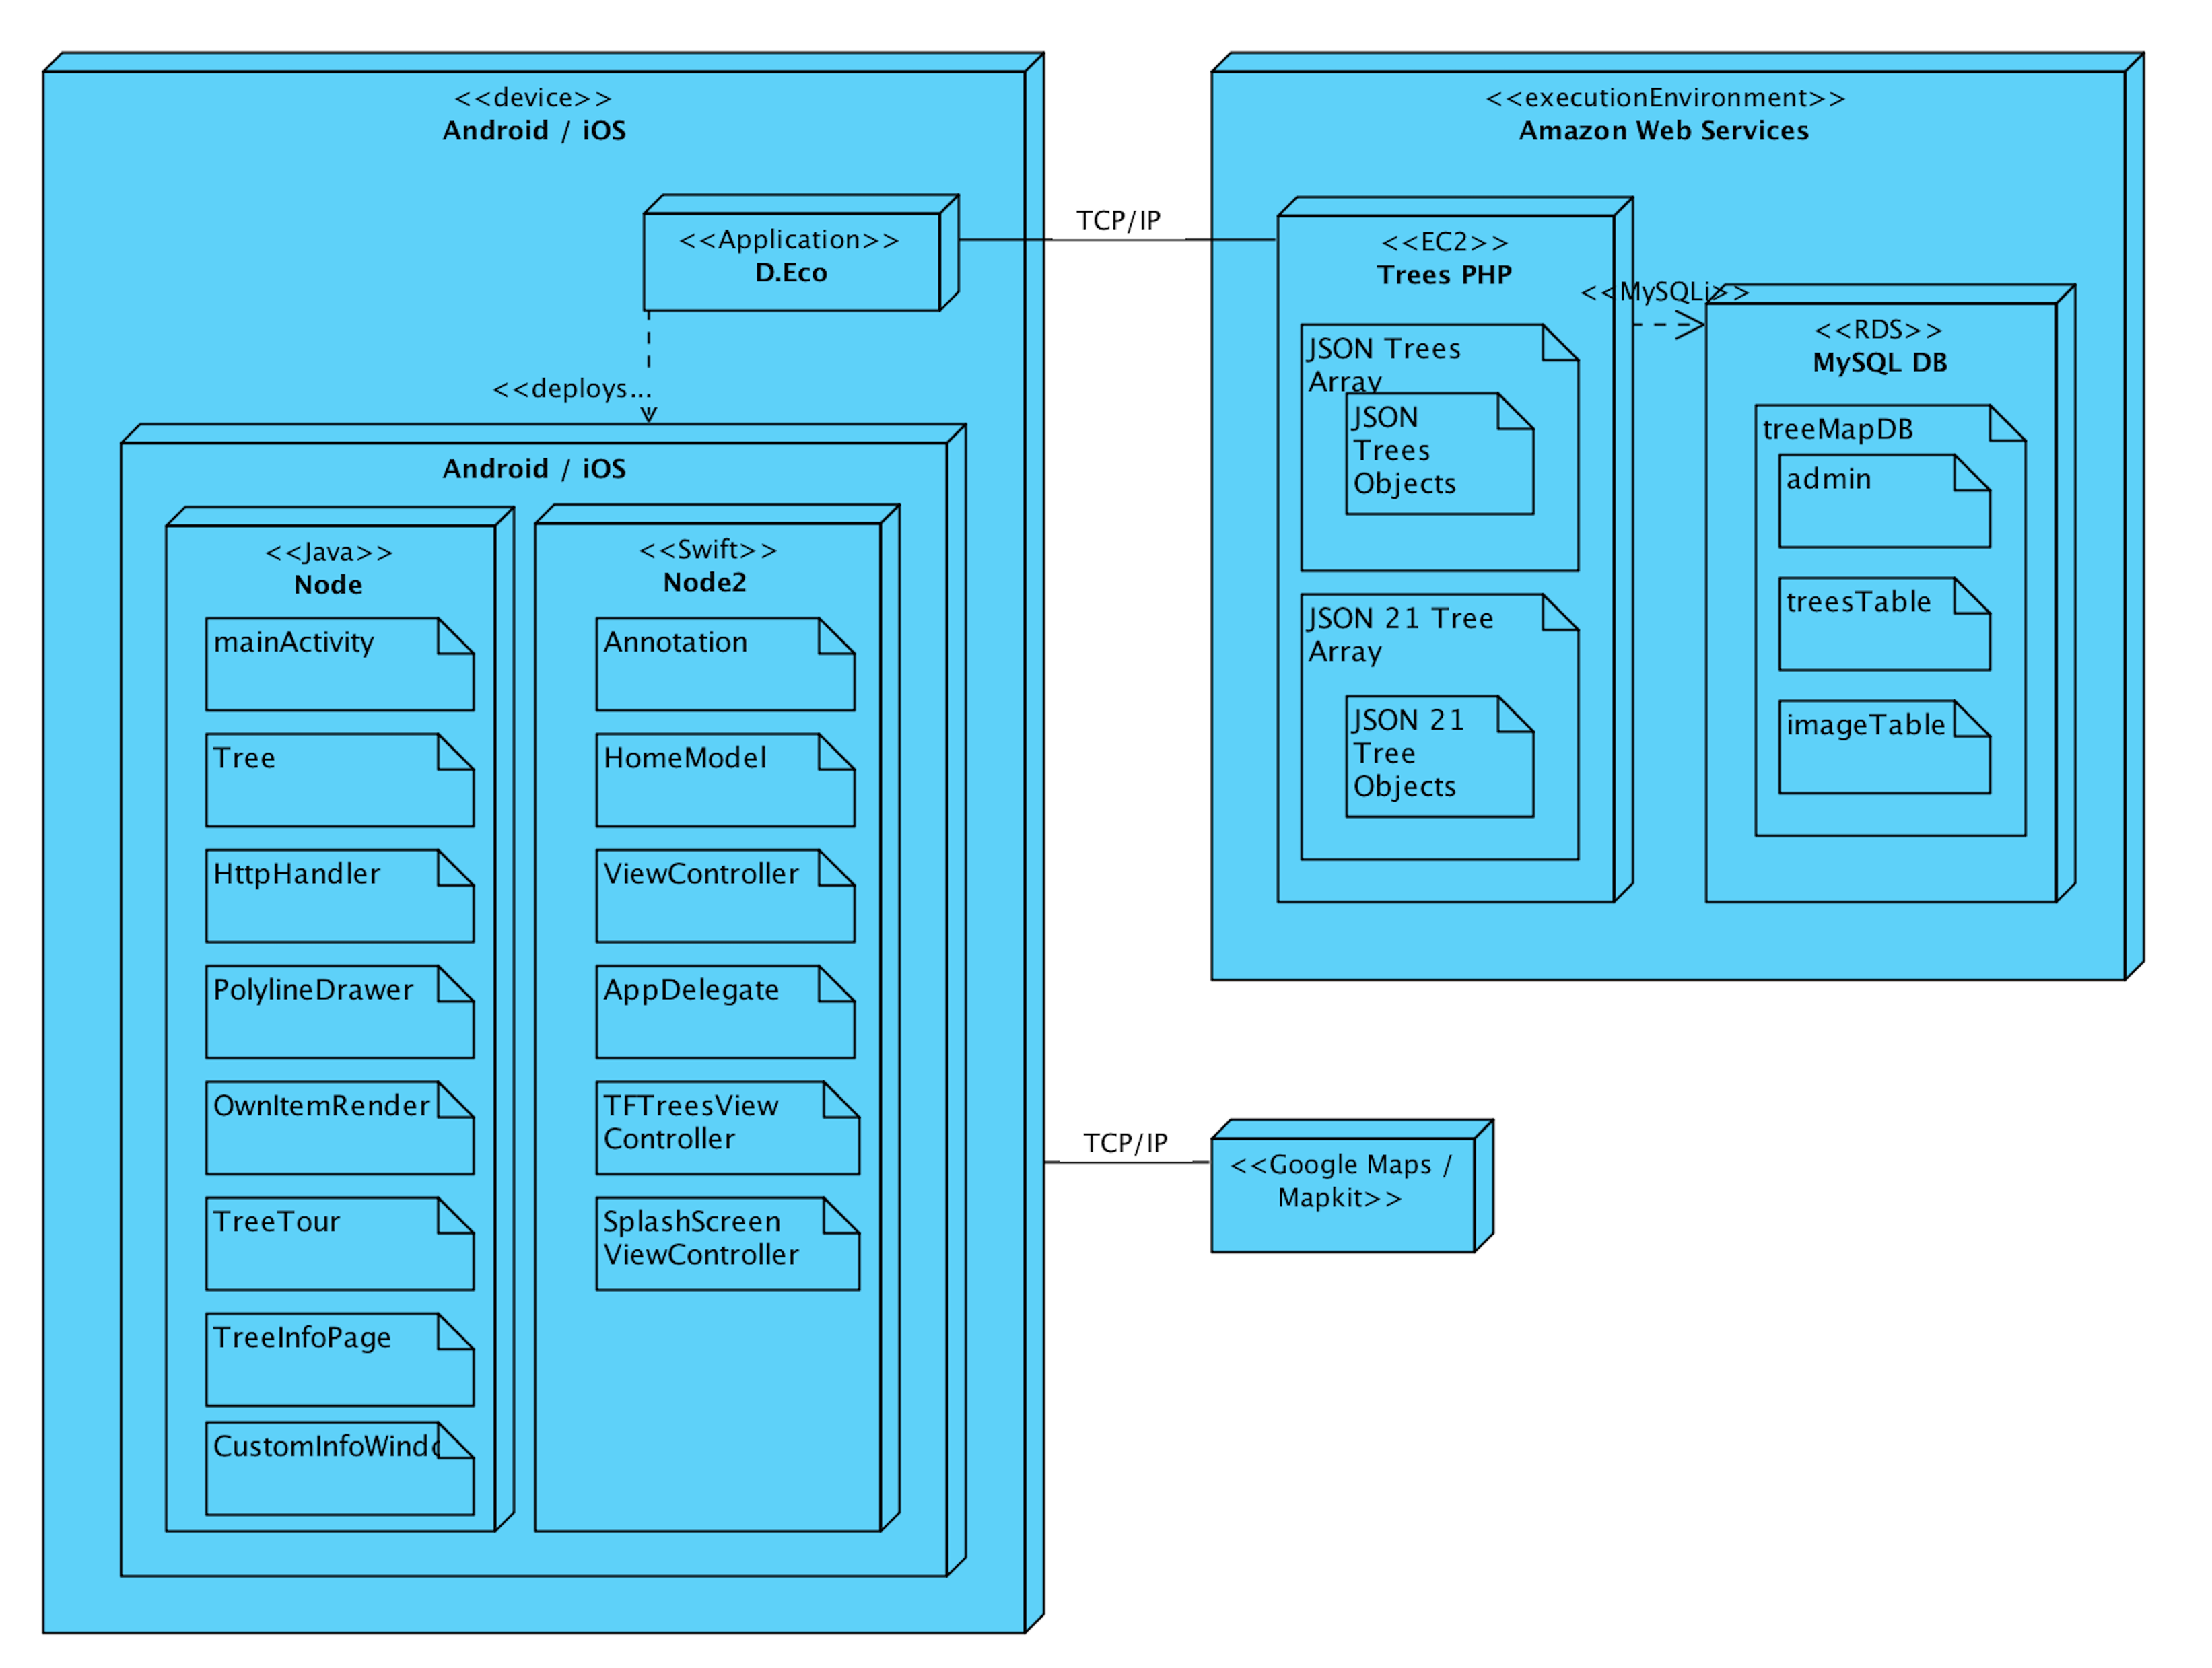
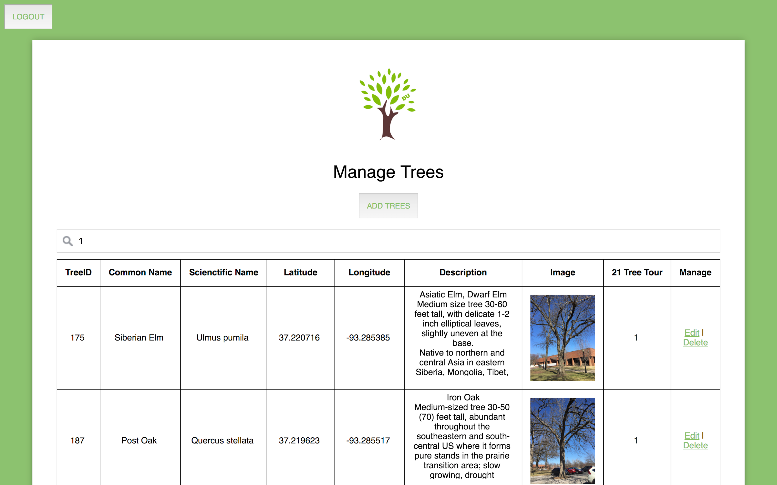

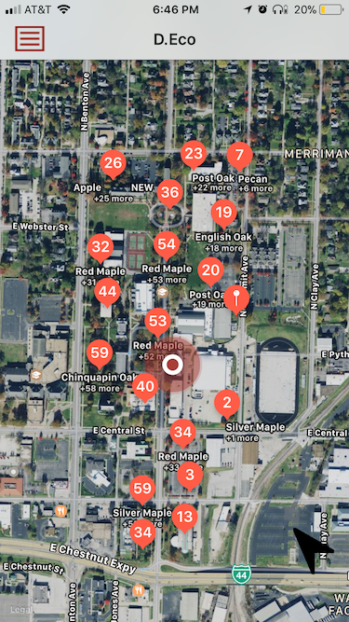
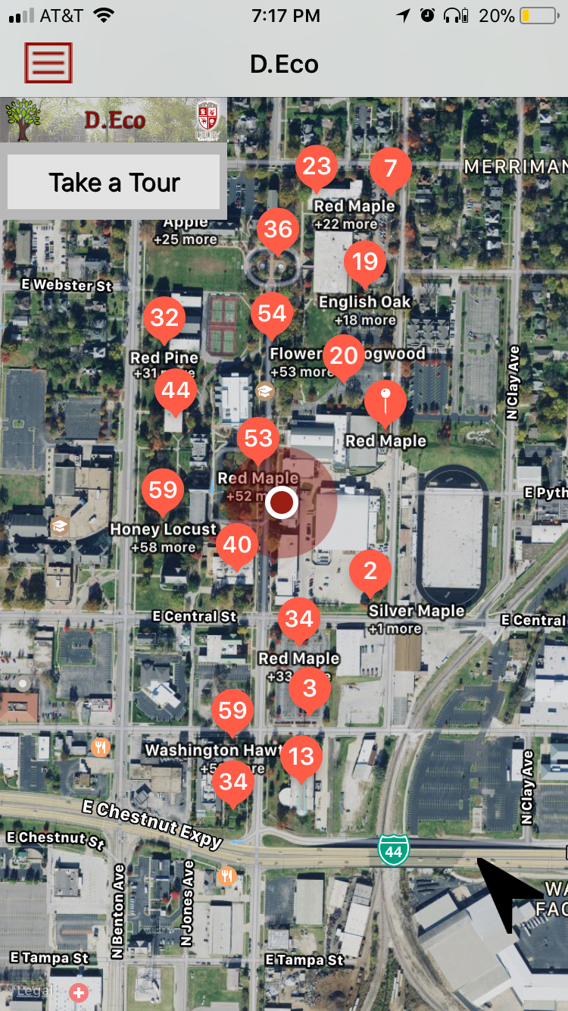
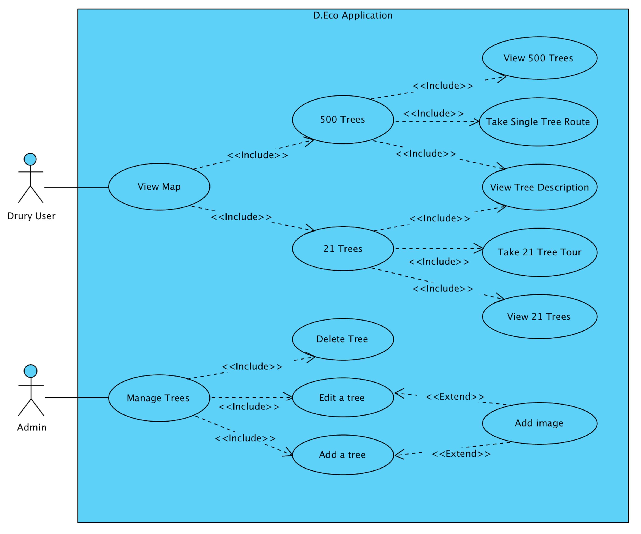
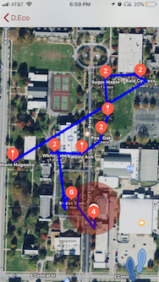
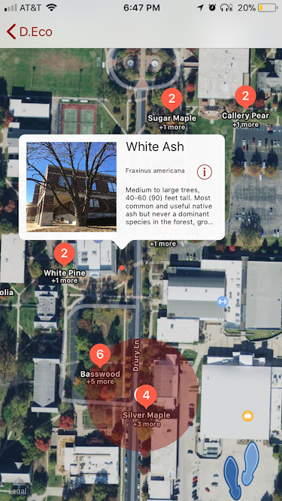
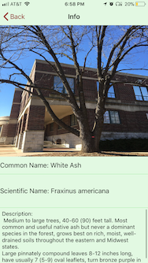
D.Eco
Students: Faisal Alsabhan, Kylie Pfaff, Cory Harris, and Morgan Brown | Mentors: Dr. Sigman and Dr. Branton
Purpose
Architecture
Web Based Administration
Android and iOS application that allows students, faculty, and visitors to tour the trees on Drury University’s campus
Educate and engage users by providing an interactive way to learn about the trees on campus
Features
A user can view a map of the campus with the 500+ annotation points that represent every tree currently documented on campus
A user can take a specific tour of the campus’ 21 unique tree species
While on the 21 Tree Tour, the user can view a specific tree’s description page which includes the common name, scientific name, short description, and an image of the tree
Interface – iOS/Android
Technologies
iOS
Swift - Xcode
Map Kit
Android
Java - Android Studio
Google Maps
Web Development
PHP - Apache
Amazon Web Services
Database
MySQL - Workbench
Requirements
Testing
Deployed both versions of the app onto Biology students phones
Students use the app to find errors in the software or tree data
Future Direction
A user can view a list of the 21 trees, tree species, and memorial trees
A user can create their own tour from the specified list of trees and view the description page for individual trees
A user can view trees, buildings, and grasses on Drury’s campus

